Slide 1
Surrealism 1924 – 1950s (between World Wars I & II)
Surrealism is a 20th-century art movement that attempted to express the workings of the subconscious.

Slide 2
Surrealism
unexpected or irrational objects in an atmosphere of fantasy,
imagery from dreams and the subconscious,
often distorting forms of ordinary objects or placing them in new contexts.

Slide 3
Jerry Uelsmann: well known surreal photographer
Made entirely in the darkroom, Uelsmann creates his surreal photographs in a series of steps, masking and exposing different areas of photosensitive paper as he changes negatives.

Slide 4
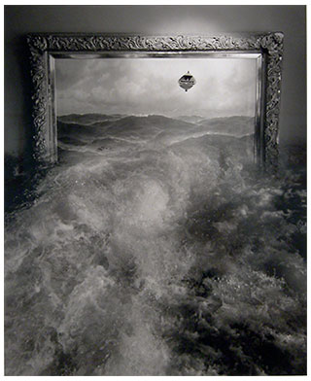
Created by having several negatives in different enlargers and moving the photo paper from one to the other, "dodging" and "burning" sections of the images to create a seamless, flawless single print.

Slide 5
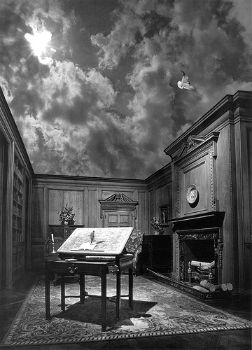

Slide 6
Other Surrealist Artist….

Slide 7
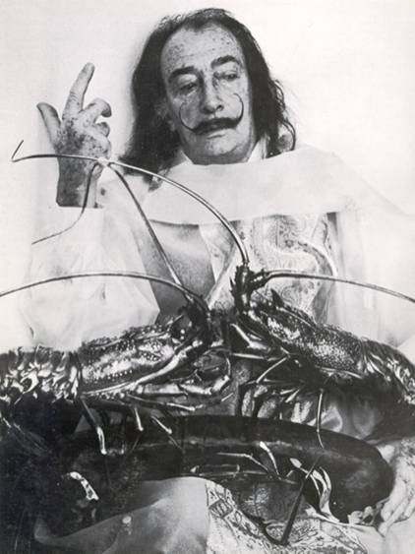
Salvador Dali
At the young age of 10, Dalí first began painting
Dalí embraced all the science of painting as a way to study the psyche through subconscious images.
Dies of heart failure in 1989

Slide 8
Salvador Dali

Slide 9
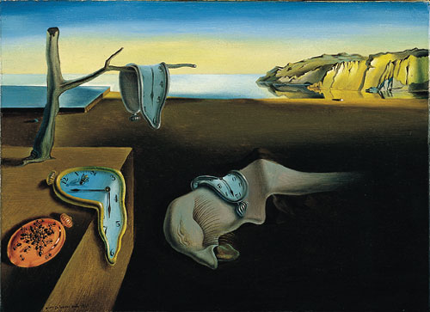
Salvador Dali, The Persistence Of Memory, 1931.

Slide 10
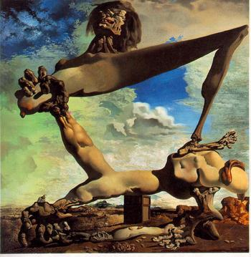
Dali, Soft Boiled Beans, 1936.

Slide 11
The images of Salvador Dali are very realistically rendered. He was a superb draftsman and used that ability to create a dreamlike or nightmarish reality of his own.
This image called Soft Boiled Beans was also said to be his premonition about the Spanish Civil War.
Dali, Soft Boiled Beans, 1936.

Slide 12
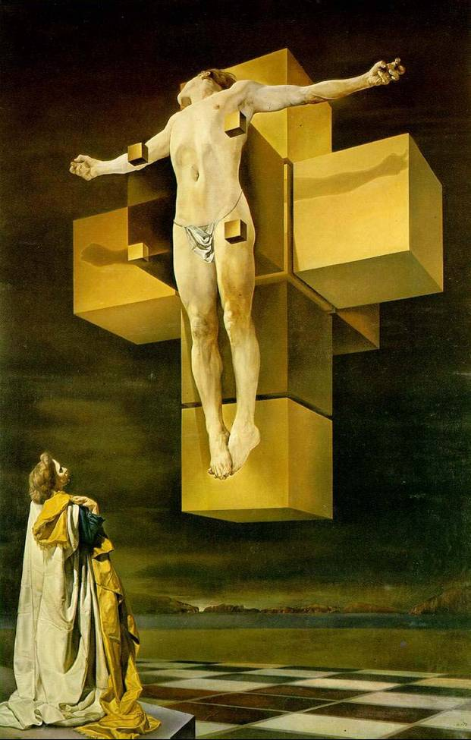
Salvador Dali

Slide 14
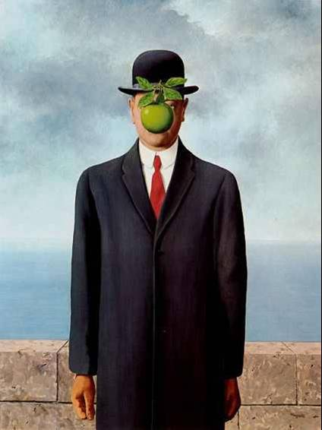
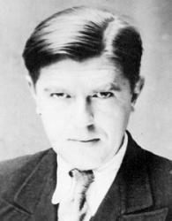
Rene Magritte(mag-REET) (1898-1967)
Rene Magritte, The Son of Man, 1964.

Slide 15
Rene Magritte (1898-1967)
Mother committed suicide when Magritte was 14
Known for placing realistic objects together in absurd combinations
Rene Magritte, The Son of Man, 1964.

Slide 16
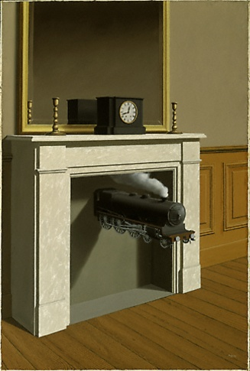
Rene Magritte

Slide 17
Pierre Roy

Slide 18
Surrealistic Techniques
“How to make the ordinary look extraordinary”

Slide 19
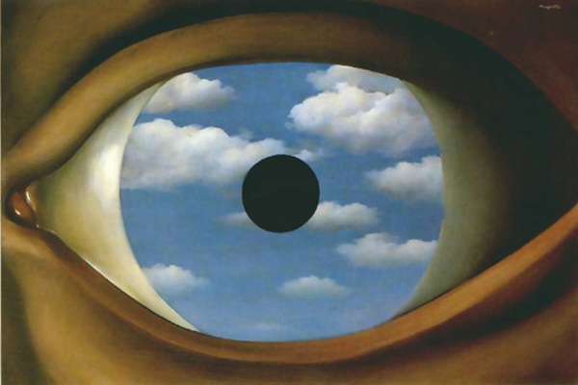
Picture in Picture

Slide 20
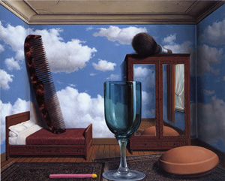
Scale
When an object is very small or very large in comparison to it's environment.

Slide 21
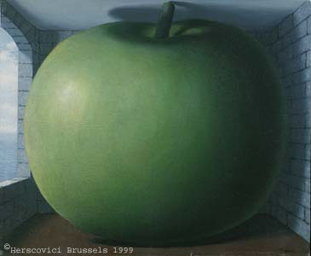

Slide 22
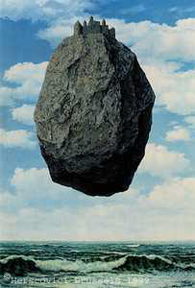
Levitation
Floating objects that don’t normally float

Slide 23
Collage

Slide 25
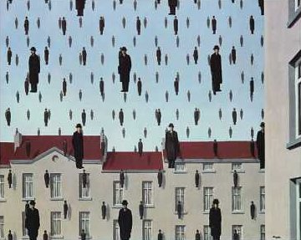
Repetition
Repeating an element in a pattern.

Slide 27
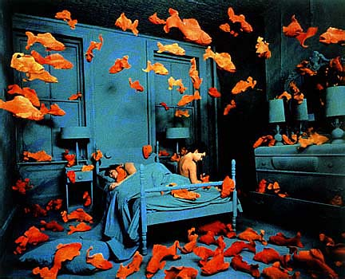
Sandy Skoglund, Revenge

Slide 28
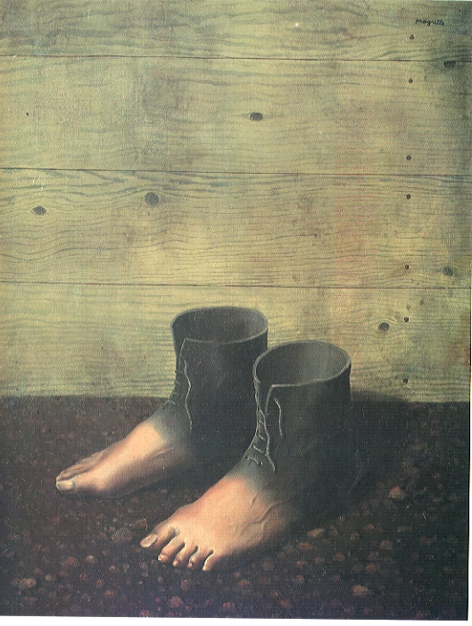
Metamorphosis
Change or Transformation of one thing into another.

Slide 29
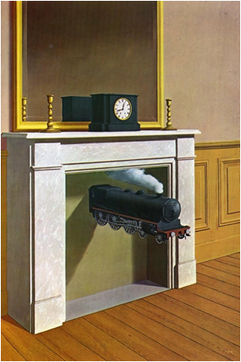
Dislocation
Taking objects from their usual locations and placing them in unfamiliar ones.

Slide 31
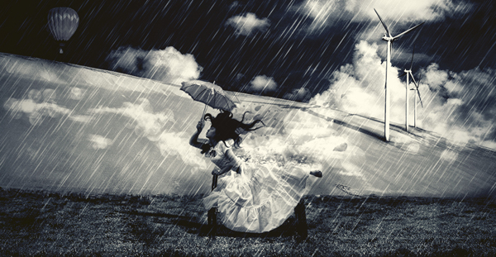
Surreal Project: Make a photomontage based on surrealism using a minimum of 5 source images.

Slide 32
Surrealism Review
What is Surrealism
What does Surrealist Art look like?
What elements and symbols are common in it?

